Slide 1
How to use Valivali - Overall test flow in %generatePackage() - How to write test script - How to create report

Slide 2
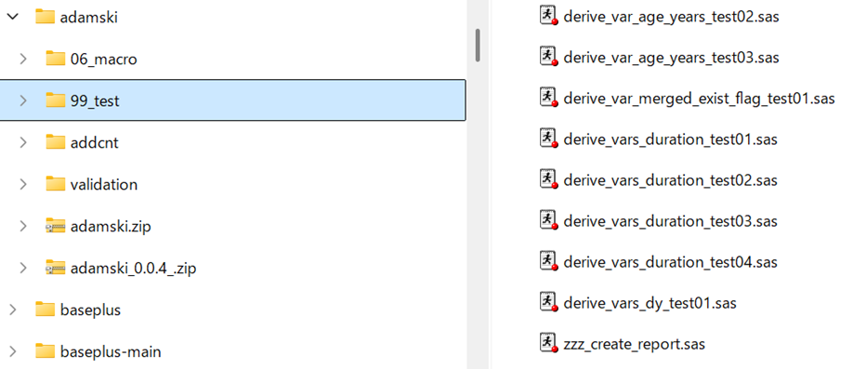
Test flow in SPF (done in %generatePackage)
Test scripts(.sas) placed in test folder(e.g. 99_test) will be executed when you generate package using %generatePackage().

Slide 3
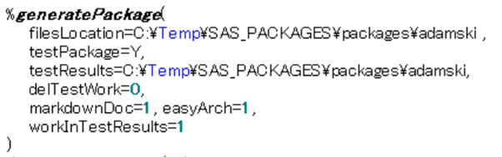
Test flow in SPF
Location of source package folder

Slide 4
Test flow in SPF
Y to execute test scripts, otherwise tests will not run.

Slide 5
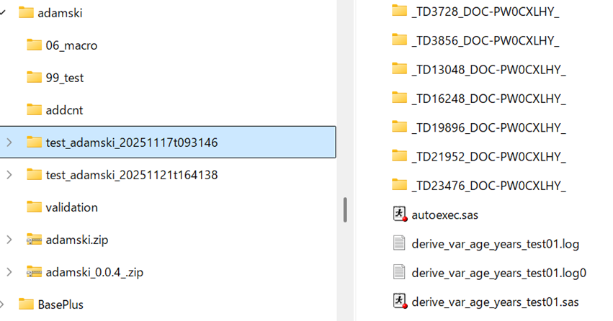
Test flow in SPF
Location of test results created. If testResults parameter is not set, results will be in temporary work directory.
By combination of delTestWork=0(do not delete work in each test session) and workInTestResults=1(work folder created in folder specified in testResults=)

Slide 6
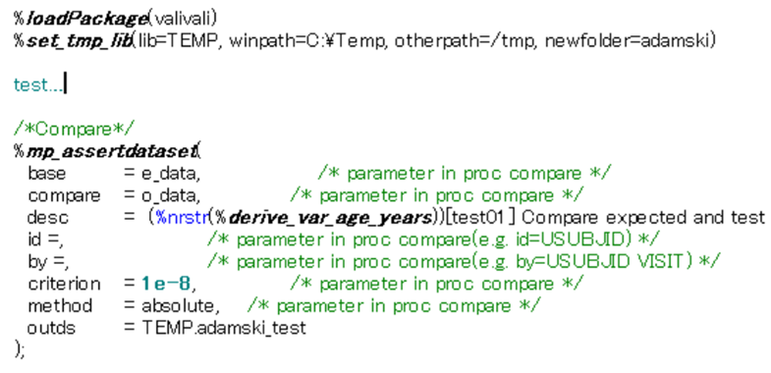
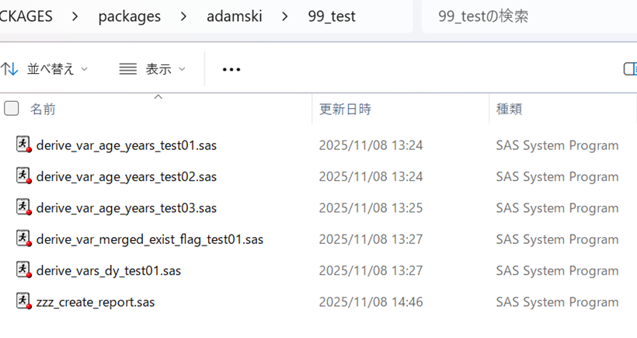
How to write test scripts
Load {valivali}
Set up libname (can use valivali)
Create your test contents (e.g. expected data and test data)
Use assert macros in valivali
Set up a consistent lib reference across all test scripts is key to integrate results into a dataset.
This is because test scripts will be executed in separate sub-sessions in %generatePackage().

Slide 7
How to write test scripts
Load {valivali}
Set up libname (can use valivali)
Create your test contents (e.g. expected data and test data)
Use assert macros in valivali
%set_tmp_lib is a very small macro to create libname for Windows/Linux. You may or may not use.

Slide 8
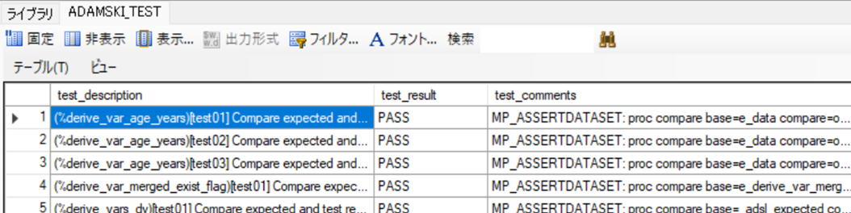
How to write test scripts
Load {valivali}
Set up libname (can use valivali)
Create your test contents (e.g. expected data and test data)
Use assert macros in valivali
Assertion macros generate and append record of test result to output dataset.

Slide 9
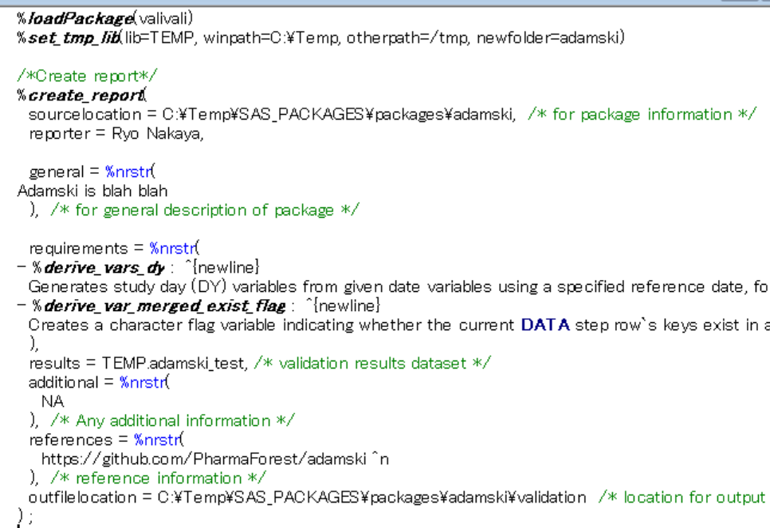
How to create report
Create report at last.
(zzz is to run it lastly)
Load {valivali}
Set up libname (can use valivali)
Use %create_report in valivali

Slide 10
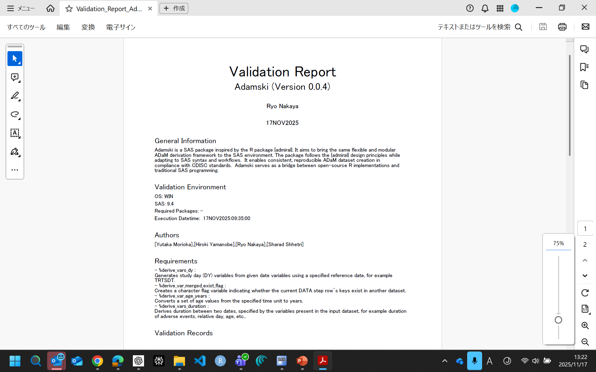
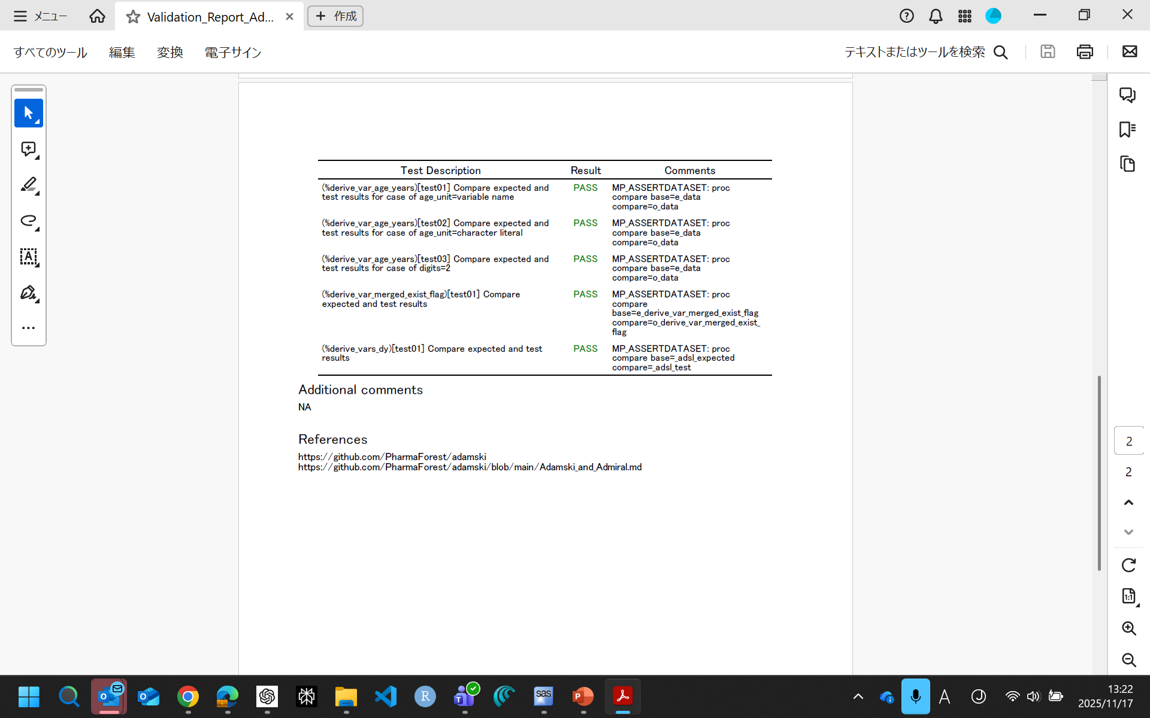








Automatically extracted from session info and package source file(description.sas)
Bring from result dataset
Manually describe in macro parameters
Fixed

Slide 11
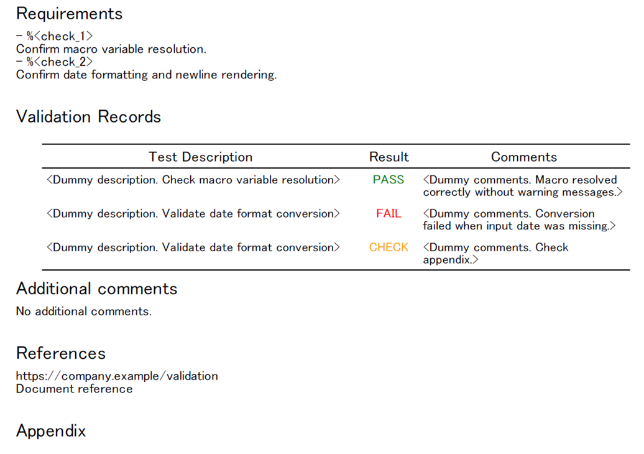
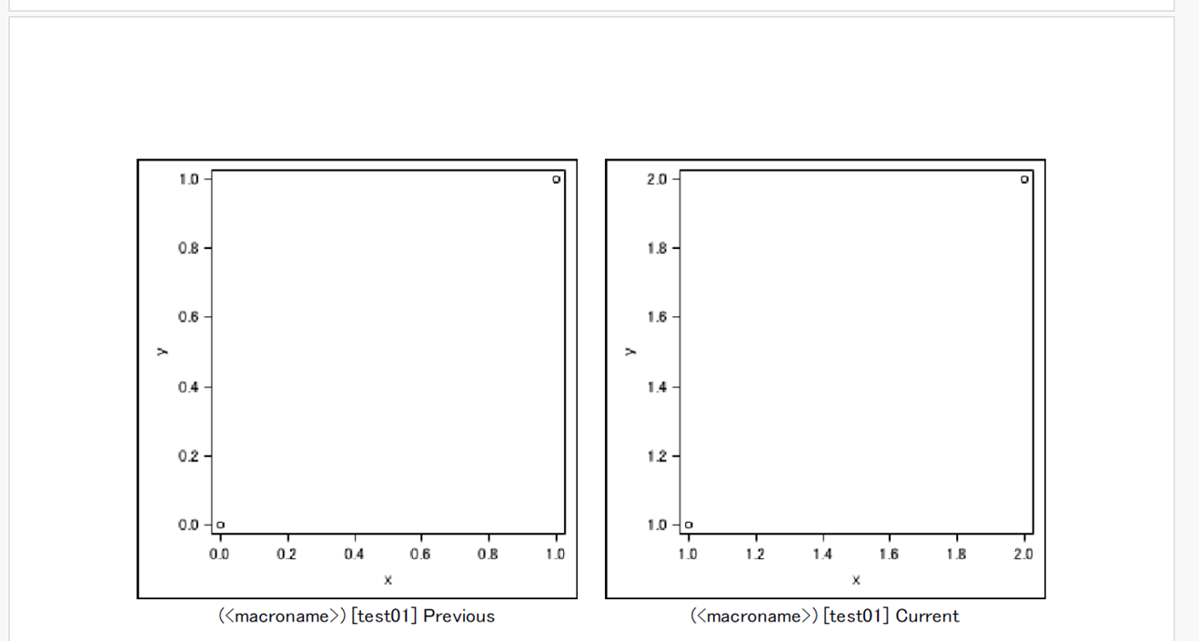
Graph
%mp_assertgraph() creates record with test_result=“CHECK” and paths for previous and current graphs
Graph should be created in test contents part before running %mp_assertgraph.
- %create_report() creates Appendix with graphs placed based on gpath1/gpath2 with test_target and test_ID.
(e.g. test_target=%swimmer_plot, test_ID=test01)
test_target and test_ID to be created automatically if test_description starts from (xxx) [yyy]. (xxx=test_target, yyy=test_ID)
Users should visually review graph outputs

